Slide 1
Bus Boys
By: Josh Millford, Tucker Howard, Gihad Elgendy

Slide 2

Java Swing

Slide 3

intelliJ IDEA Commmunity

Slide 4

Mysql Workbench

Slide 5
History
Bus Boys is a failing public transportation company. Their sales have been dropping off slowly over the past few years due to their inability to keep up with the competition. They have decided to take a more tech savvy route and have come to us for help to make an application that would attract more people and retain old customers. Their company has all the right stuff to succeed. The only problem is they are late in transitioning to a more computer friendly world. They need an electronic database maintain their company and an application that will bring in new people and help retain older people.

Slide 6
Bus Boys
Location: Baltimore, Maryland
Number of branches: Currently 3 branches
Size of the business: about 20 people
Total sales: Bringing in about 1,500,000 per year
Target Area: Maryland near Baltimore Area. Hoping to branch out as time goes on.
Services: Public transportation. Public busing system. Private bus reservation system with driver. Taxi reservation system.

Slide 7
Business Process Taxi
First the Customer Opens the application.
Once the application is open the user should press Request
Once the Request page is open the user should select an available taxi from the dropdown menu.
Once they have selected an available taxi they should press request.
The database is then updated by making that taxi currently reserved and unavailable for others to reserve. The application does the same thing
The customer should get a unique reservation number and so should the driver of the taxi. They should have the same one to authenticate that this is the person who made the reservation.

Slide 8
Business Process Taxi
The application automatically notifies the taxi driver where the customer is.
The taxi driver goes to pick up the customer
The customer is taken to their destination
The customer pays the driver in some form cash, or credit.
The price of the ride is already calculated and stored on the database, so the station will be expecting that amount to come in from the taxi driver if the person payed in cash.
The Taxi driver brings back their earnings in cash to the station they work at by the end of the day.

Slide 9
Business Process Public Bus
First the customer opens the application
Once the application is open they can check the routes of the buses by pressing the routes button on the application.
The customer goes to a bus stop and waits for the bus to arrive.
The bus arrives, and the customer gets on and pays a set fee for the bus ride in cash.
The customer stays on until they get to their destination.
The bus driver takes back all the earnings to their station by the end of the day.

Slide 10
Requirements Application
An application that where Customers can request a taxi, from currently available taxis, and let them have a personal reservation number for their taxi reservation.
If a taxi is reserved, no one else should be able to reserve it.
An application where Employees can login to their accounts and see their information and what is currently stored on the database about them.

Slide 11
Requirements Application
An application where Supervisors can login to their accounts and see what station they supervise and all the employees they supervise separated by their profession, such as mechanic, cashiers, etc.
An Administrator account where the Administrator can add, and delete vehicles, and has the capability of adding, and deleting employees from the database.

Slide 12
Requirements Application
The application should properly be able to display the company’s contact information, and should have a place for users to submit complaints.
The application should be able to display bus routes for people looking to use the transit buses.

Slide 13
Requirements Database
Every Vehicle should have a unique Vehicle id
Every Employee should have a unique Employee id
Every Station should have a unique number and name.
One Supervisor per station so every supervisor should have a unique station number
Supervisor should be able to get number of employees that work for them.

Slide 14
Requirements Database
Every Employee, Supervisor, and Administrator should have a user name and password
Every Employee should have the information of the years they’ve worked for the company
Every Employee should have their hourly wage stored on the database
Every Employee should have a first name, and last name in the database
Every Employee should have their address in the database

Slide 15
Requirements Database
Every Employee should have their station ID in the database
Every Employee should have a supervisor ID in the database
All Bus stops should be stored into the database with information including the departure and arrival time. It should also have the location. These Locations should have a stop number.

Slide 16
Requirements Database
There should be a place in the database to store fares, the amount of the fare, the date of the trip, and an identifying Fare number.
All routes should be stored in the database, with the information of Route number, Date of route, distance, an estimate of how long it takes to complete the route, and the number of stops.
Every private bus should have a start location, end location, fare, number of seats or capacity of the bus, driver id, and a bus id that matches the vehicle id.

Slide 17
Requirements database
Every public bus should have a station number, current stop, next stop, Route number, bus number, driver id, and a vehicle id.
Every Taxi should have a Taxi id, and the number of seats or its capacity.
Every driver should a Bus license number, bus number assigned to them, and an employee id.
Every Janitor should have a station number and employee id.

Slide 18
Requirements Database
Every Mechanic should have a place to show what they work on as in what type of vehicle they can work on bus or car. They should also have an employee id.
Every Cashier should have a Register Password, and an Employee id.
Every HR person should have a number of complaints, and an Employee id.

Slide 19
Requirements Database
Ever Repair Log should have Date the work started, the worker id of the one working on the vehicle repair, the id of the car being repaired, and the type of issue stored in the database
Every Station should have a station number, station name, capacity, Number of Employees that work there, Supervisor id, street, and city.
Every vehicle should have a make, model, year, and vehicle id.

Slide 20
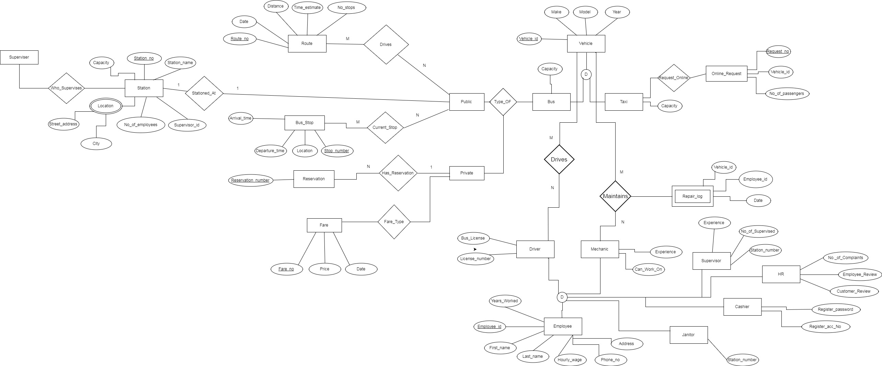
ERD

